Slide 1
Java - Uvod

Slide 2
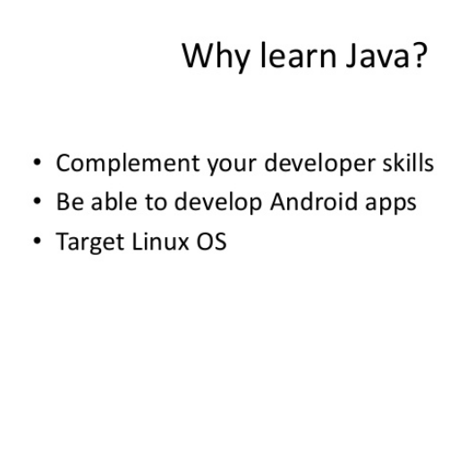

Slide 3
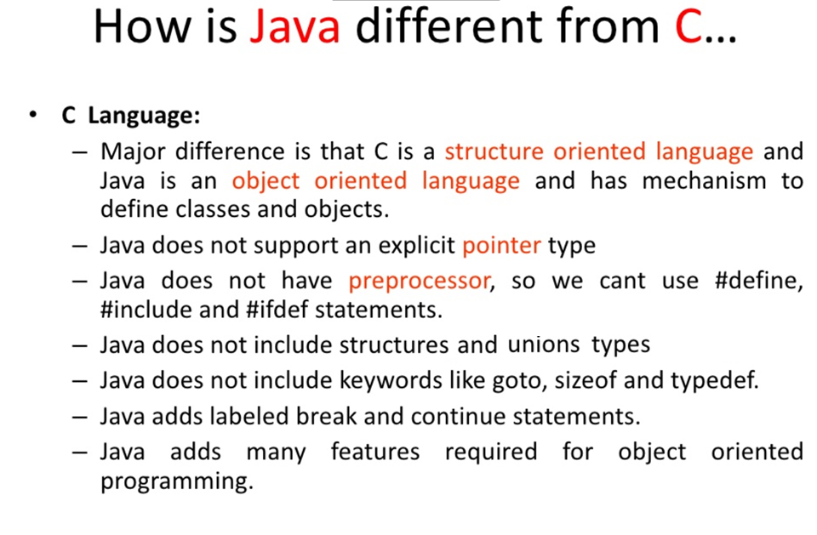
https://www.slideshare.net/VeerabadraBadra/introduction-to-java-9266993

Slide 4
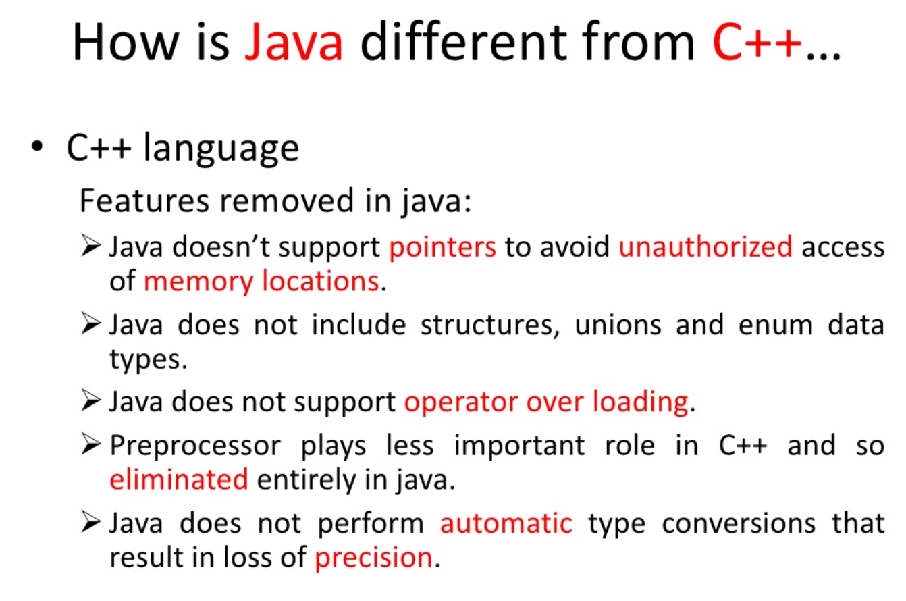
https://www.slideshare.net/VeerabadraBadra/introduction-to-java-9266993

Slide 5
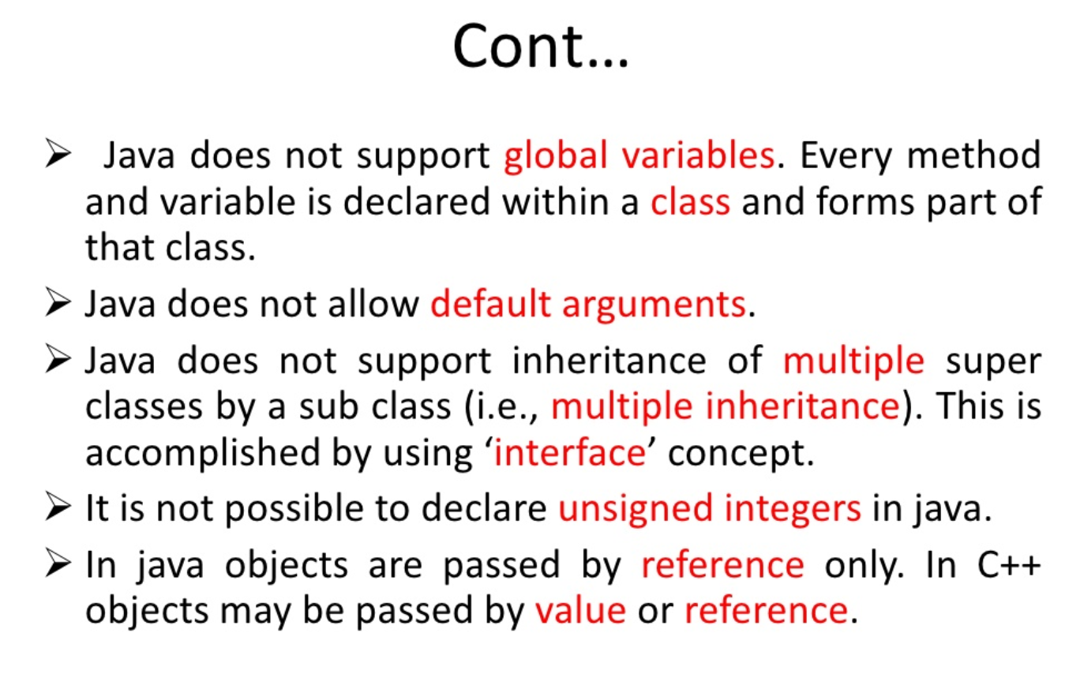
https://www.slideshare.net/VeerabadraBadra/introduction-to-java-9266993

Slide 6
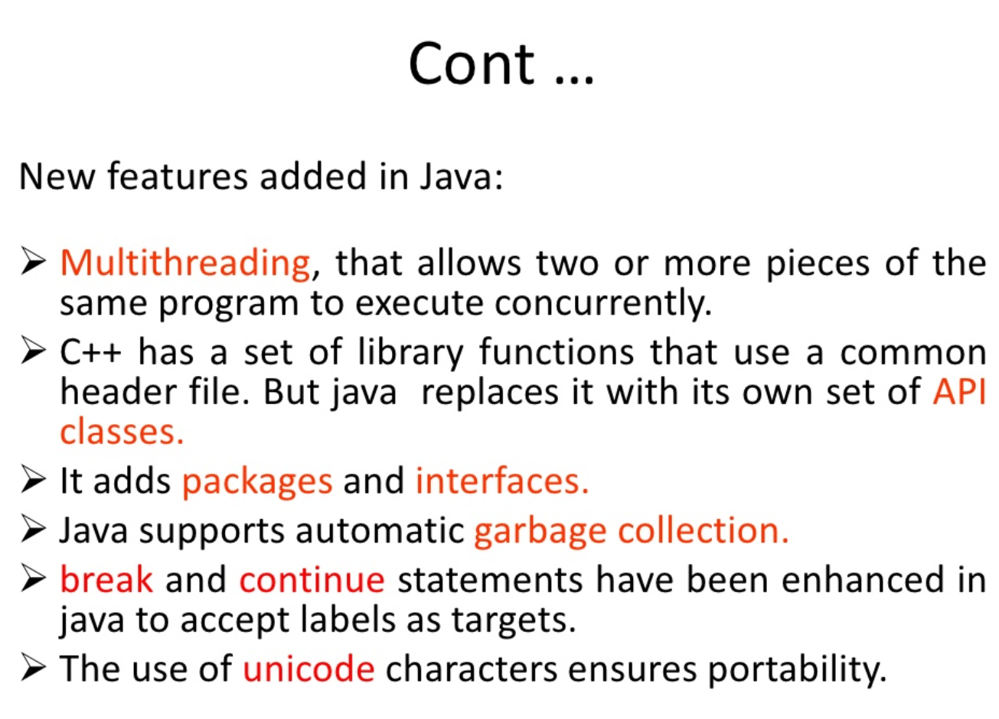
https://www.slideshare.net/VeerabadraBadra/introduction-to-java-9266993

Slide 7
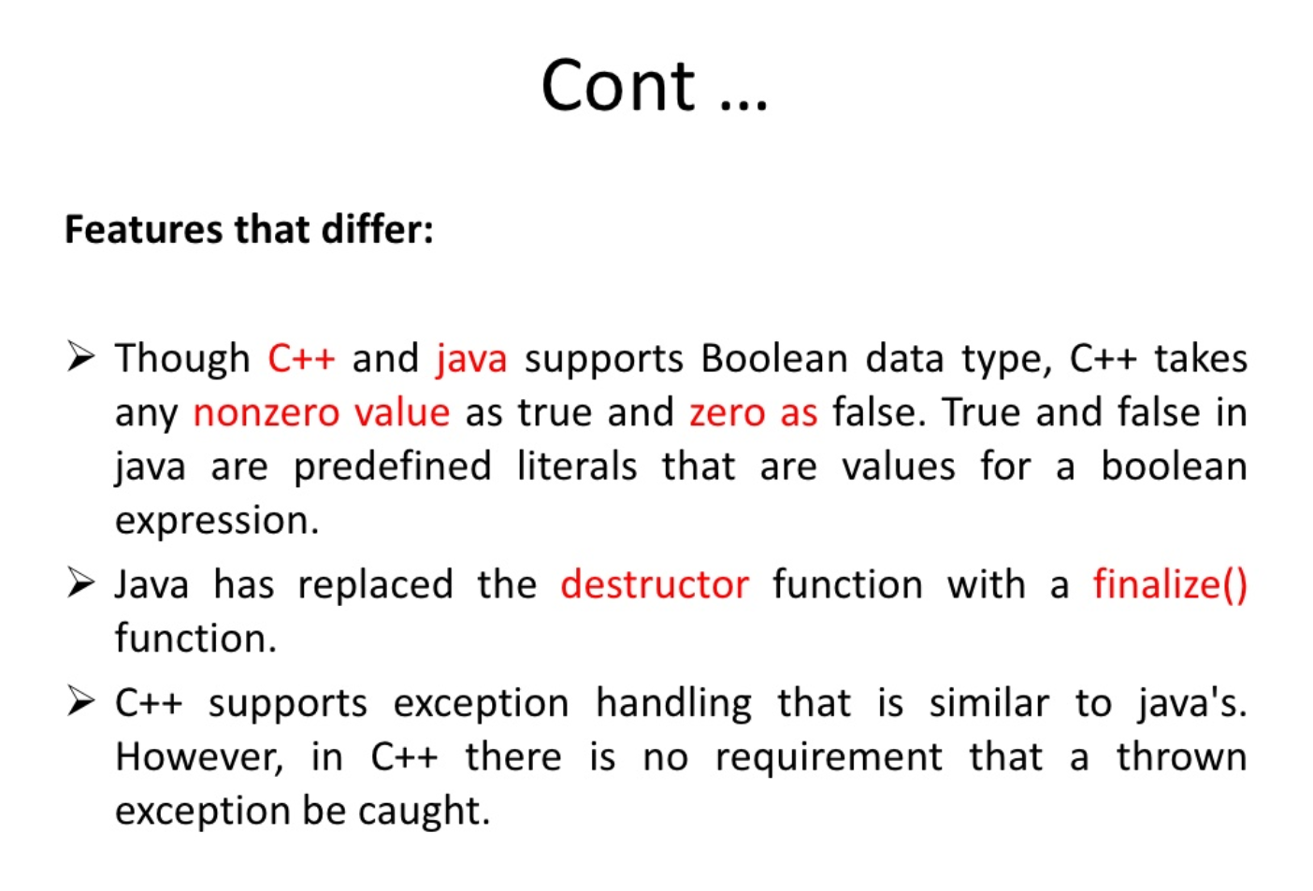
https://www.slideshare.net/VeerabadraBadra/introduction-to-java-9266993

Slide 8
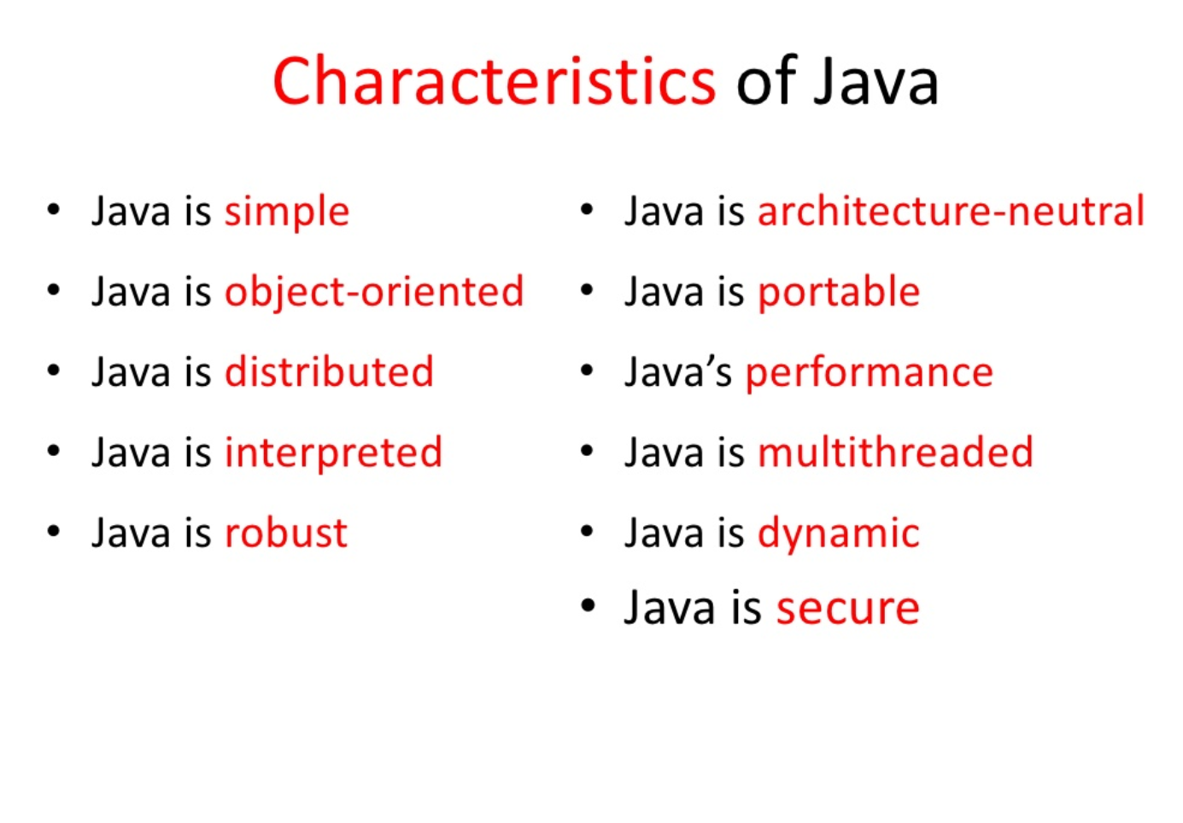
https://www.slideshare.net/VeerabadraBadra/introduction-to-java-9266993

Slide 9
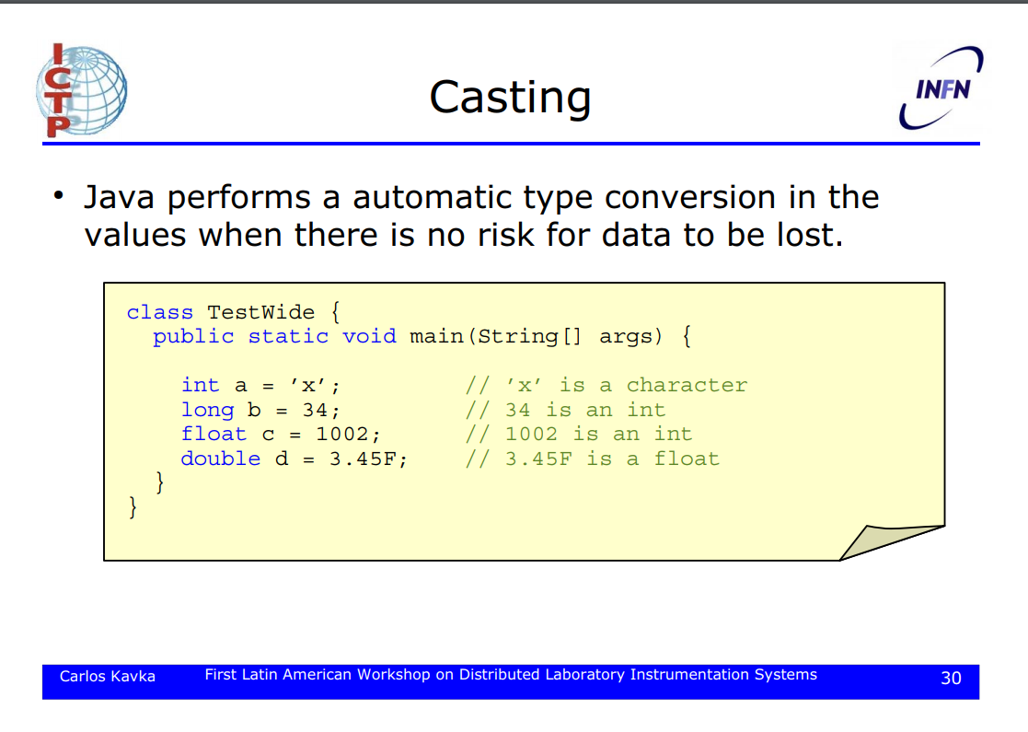
http://indico.ictp.it/event/a0727/session/7/contribution/4/material/0/1.pdf

Slide 10
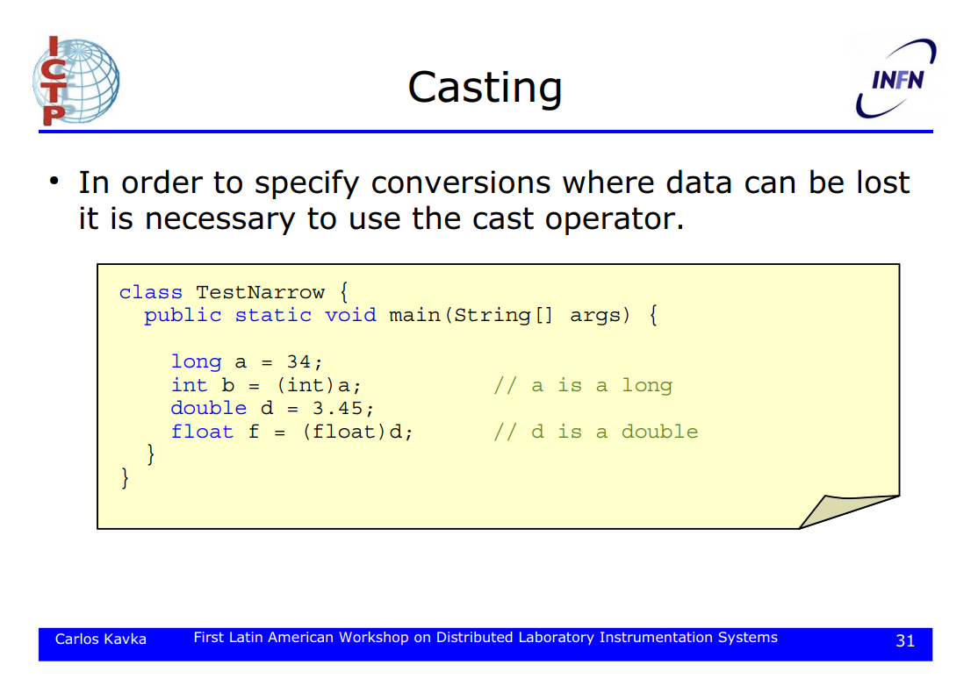
http://indico.ictp.it/event/a0727/session/7/contribution/4/material/0/1.pdf

Slide 11
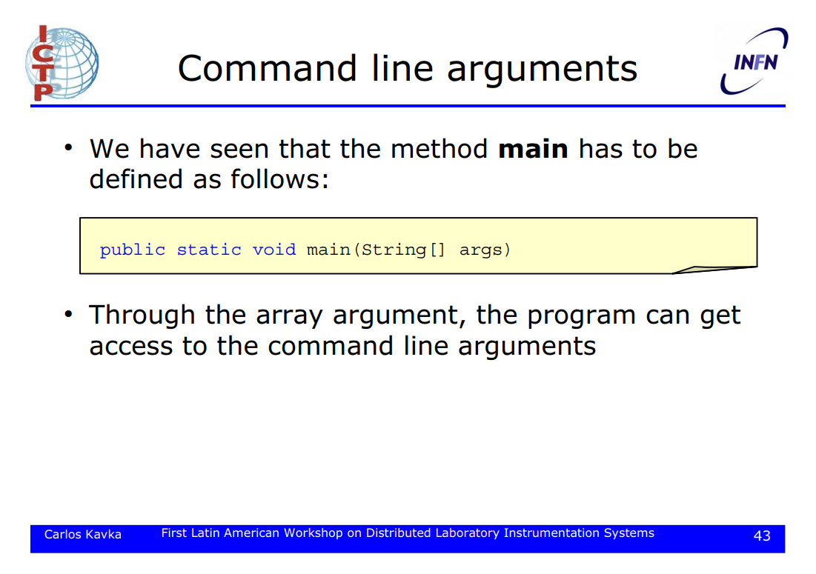
http://indico.ictp.it/event/a0727/session/7/contribution/4/material/0/1.pdf

Slide 12
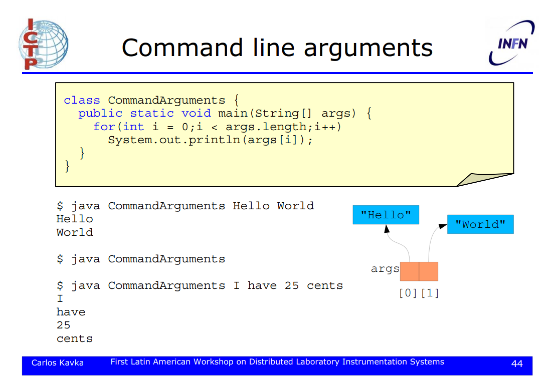
http://indico.ictp.it/event/a0727/session/7/contribution/4/material/0/1.pdf

Slide 13
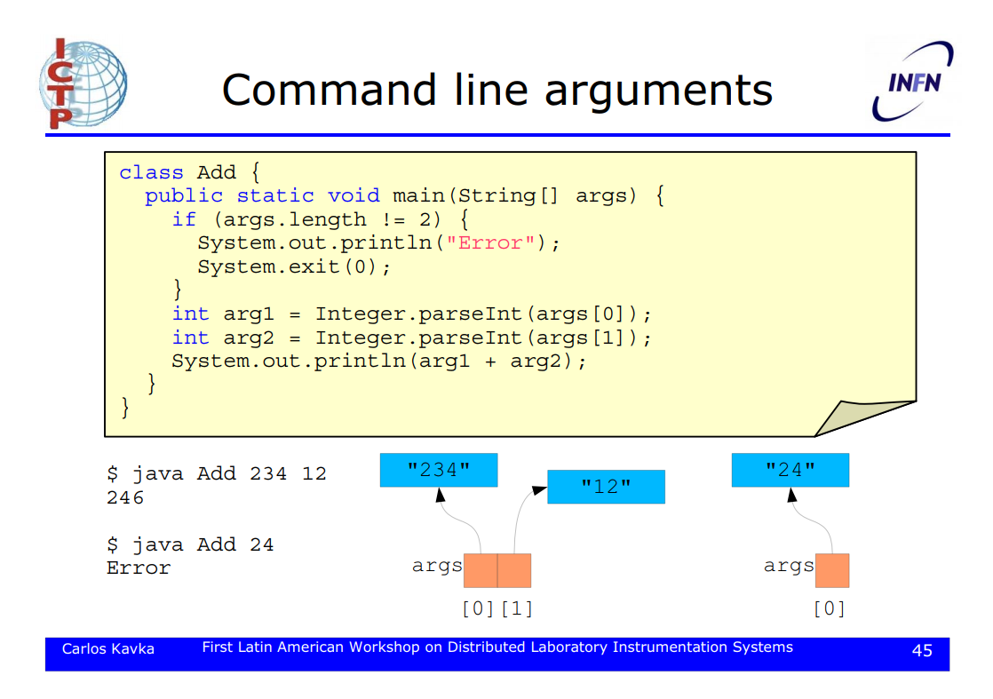
http://indico.ictp.it/event/a0727/session/7/contribution/4/material/0/1.pdf

Slide 14
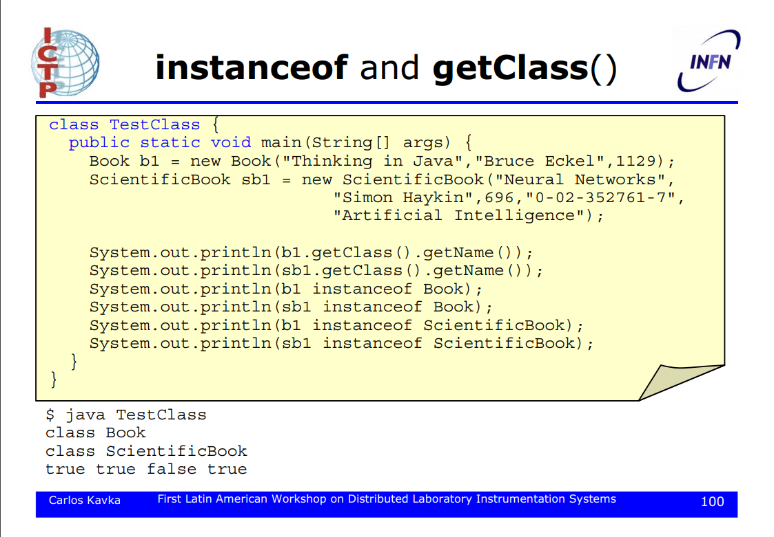
http://indico.ictp.it/event/a0727/session/7/contribution/4/material/0/1.pdf

Slide 15
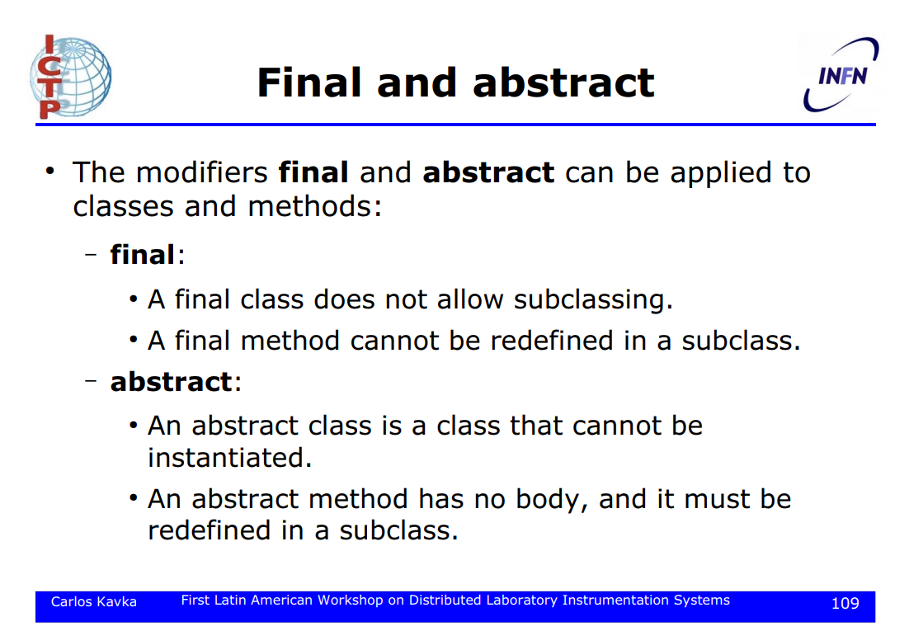
http://indico.ictp.it/event/a0727/session/7/contribution/4/material/0/1.pdf

Slide 16
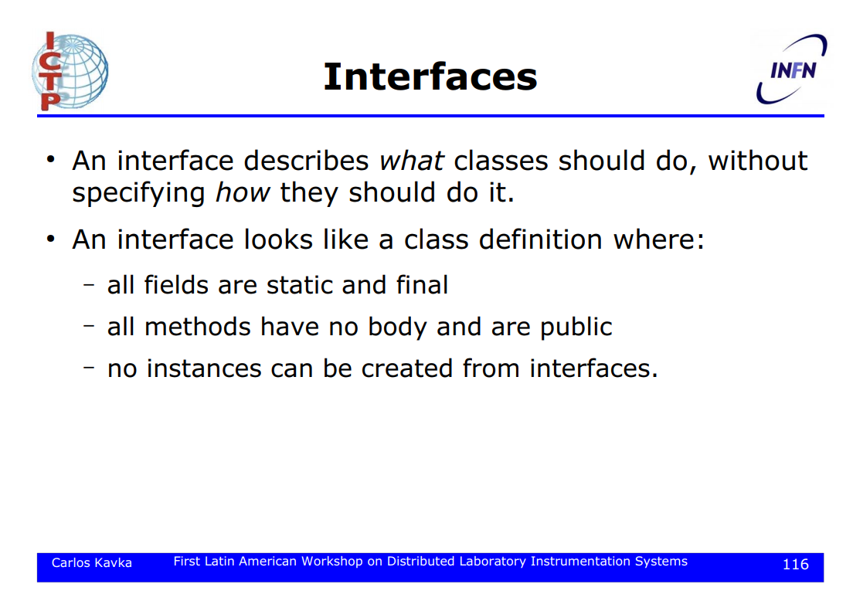
http://indico.ictp.it/event/a0727/session/7/contribution/4/material/0/1.pdf

Slide 17
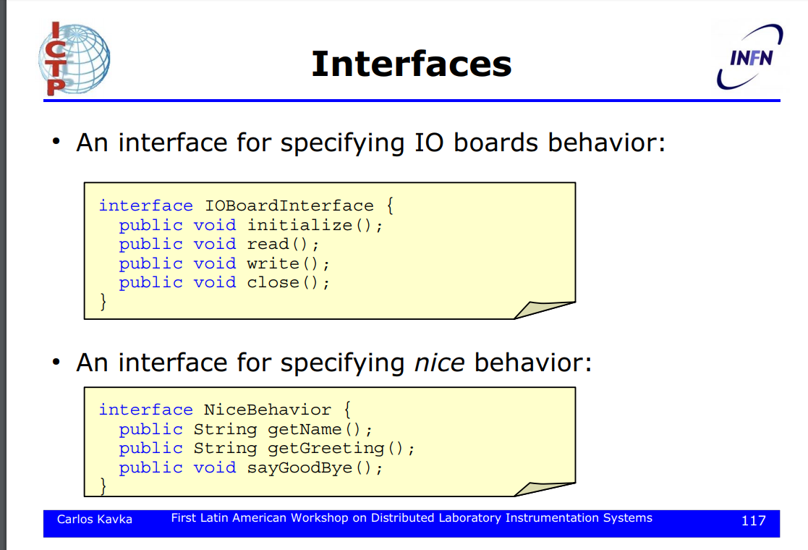
http://indico.ictp.it/event/a0727/session/7/contribution/4/material/0/1.pdf

Slide 18
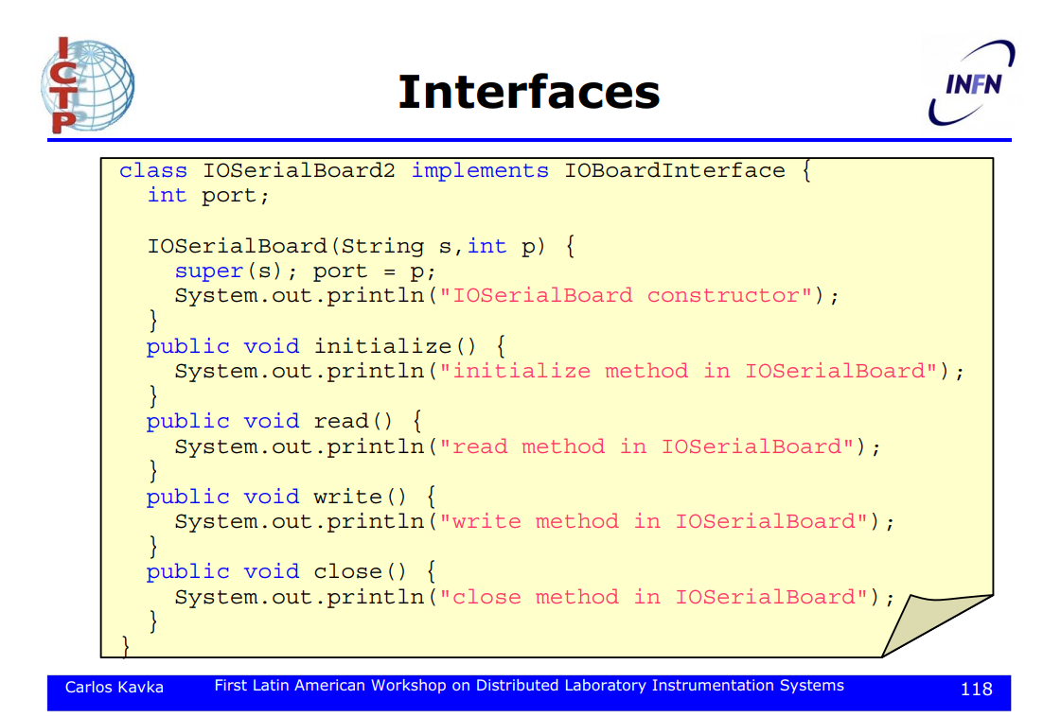
http://indico.ictp.it/event/a0727/session/7/contribution/4/material/0/1.pdf

Slide 19
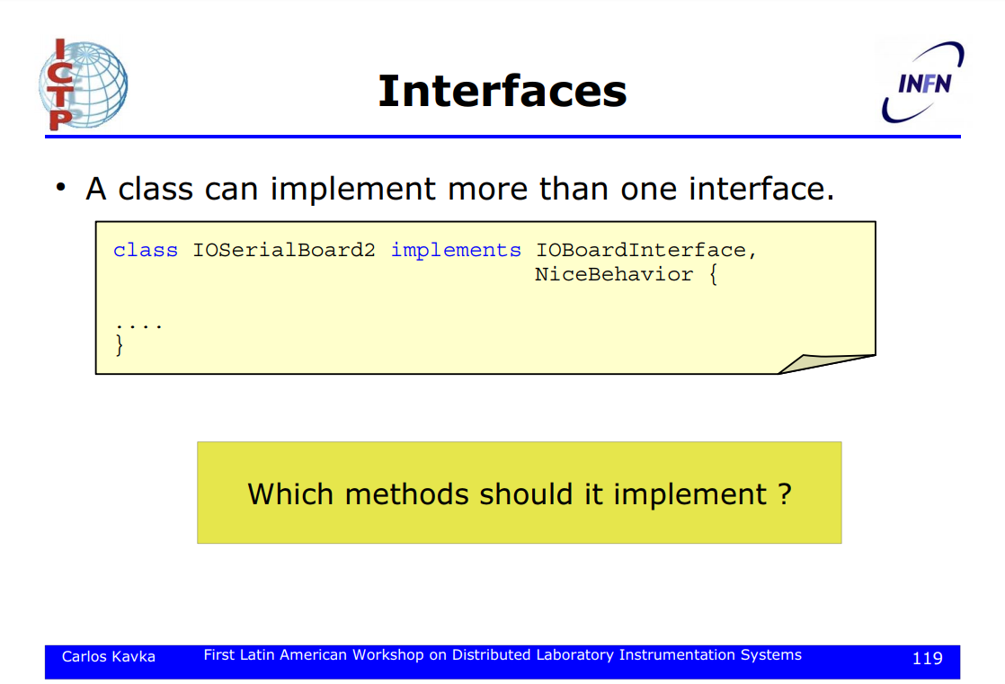
http://indico.ictp.it/event/a0727/session/7/contribution/4/material/0/1.pdf

Slide 20
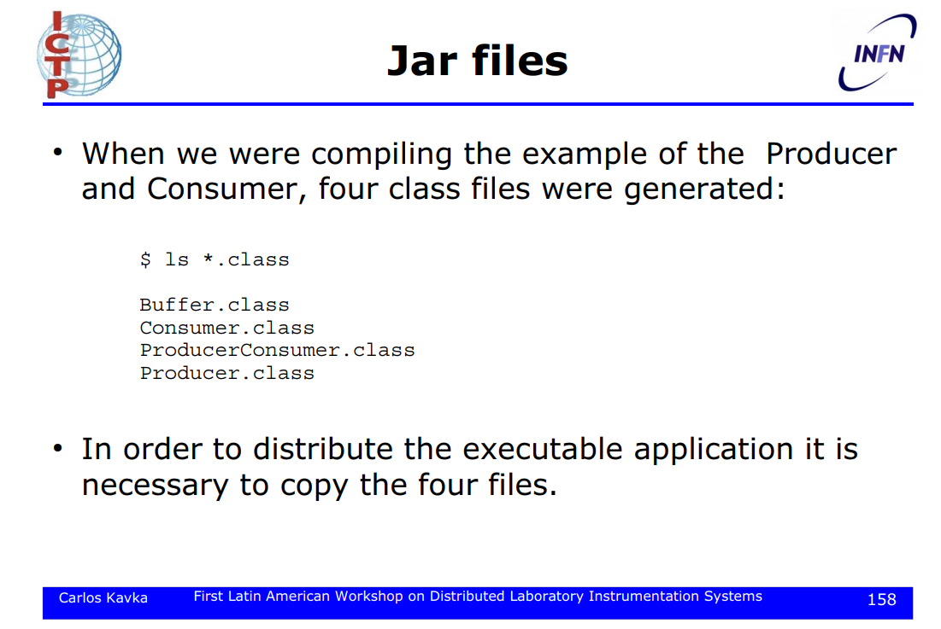
http://indico.ictp.it/event/a0727/session/7/contribution/4/material/0/1.pdf

Slide 21
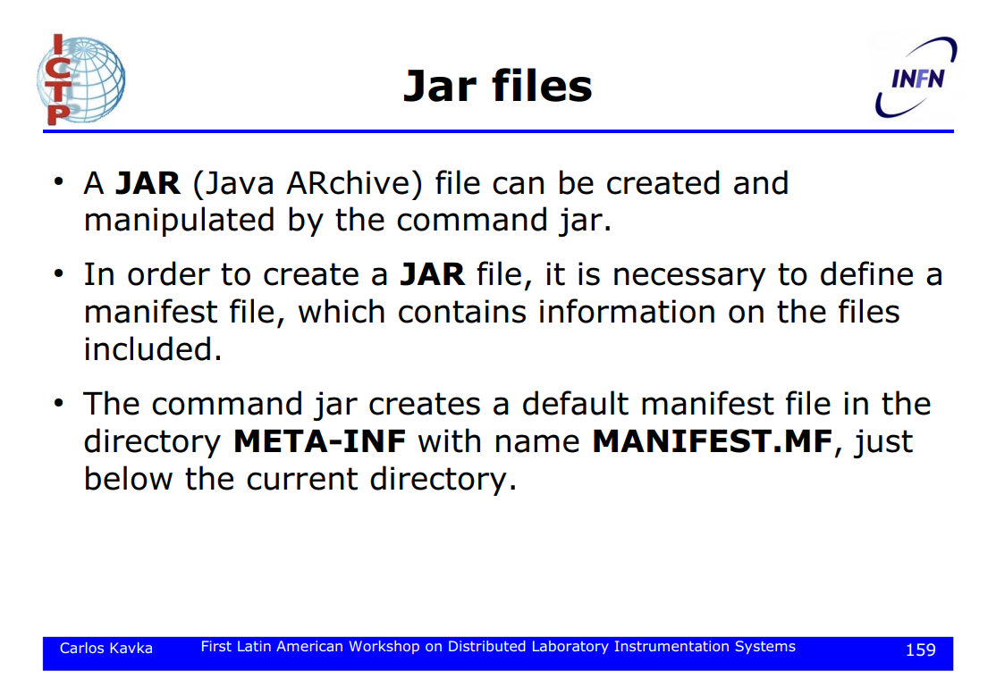
http://indico.ictp.it/event/a0727/session/7/contribution/4/material/0/1.pdf

Slide 22
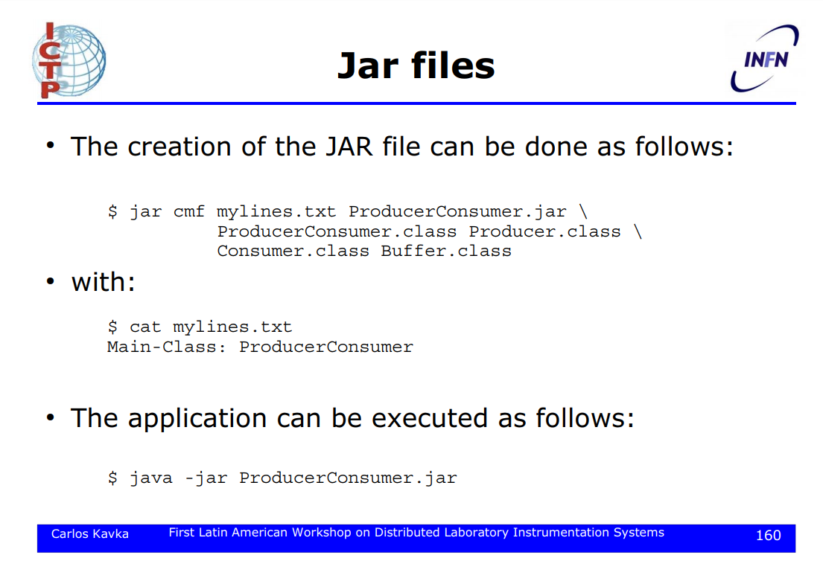
http://indico.ictp.it/event/a0727/session/7/contribution/4/material/0/1.pdf

Slide 23
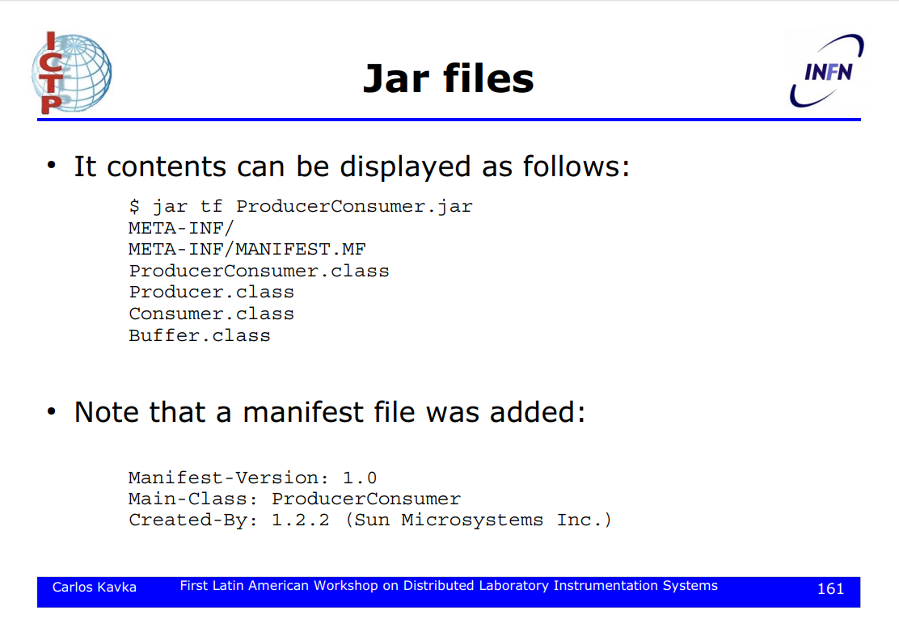
http://indico.ictp.it/event/a0727/session/7/contribution/4/material/0/1.pdf

Slide 24
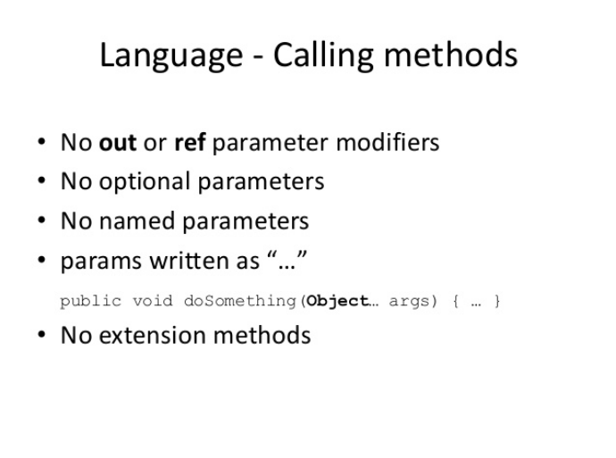

Slide 25
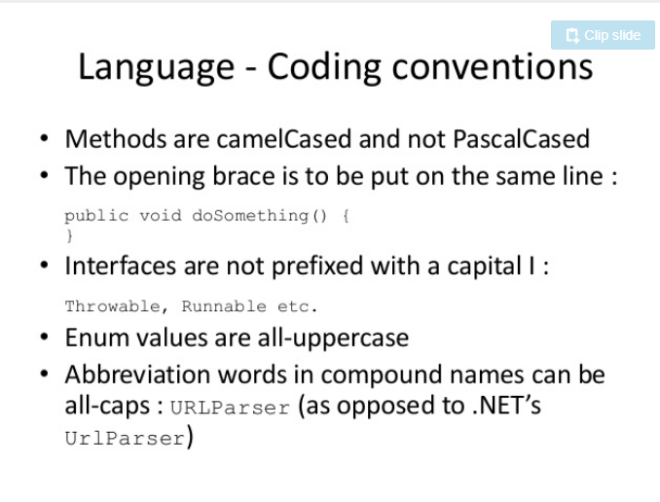

Slide 26
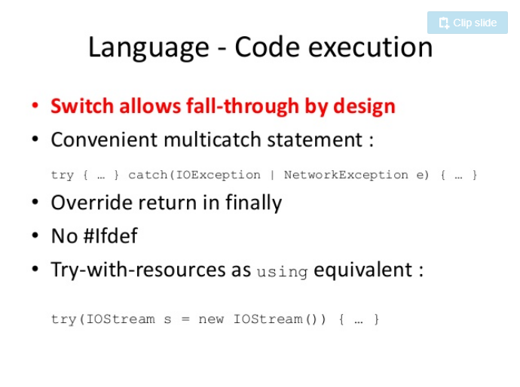

Slide 27
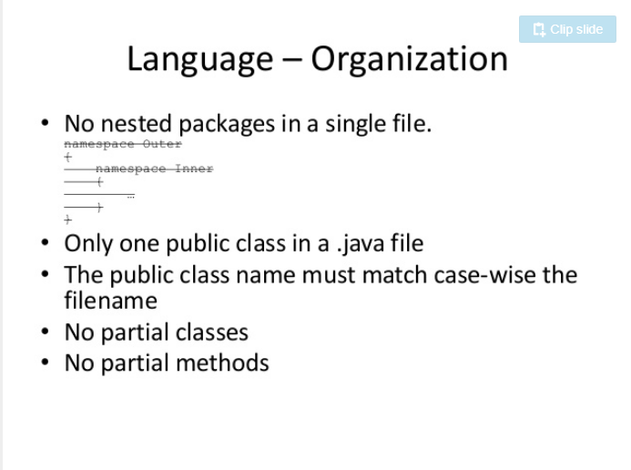

Slide 28
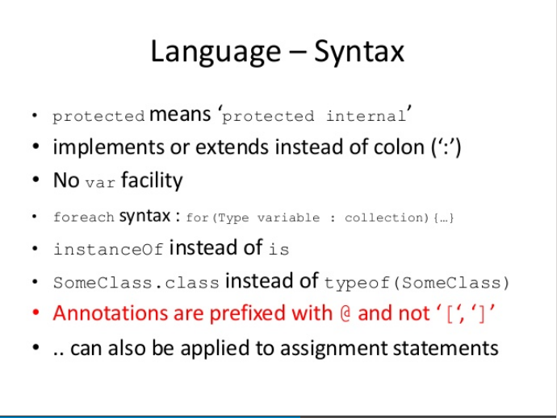

Slide 29
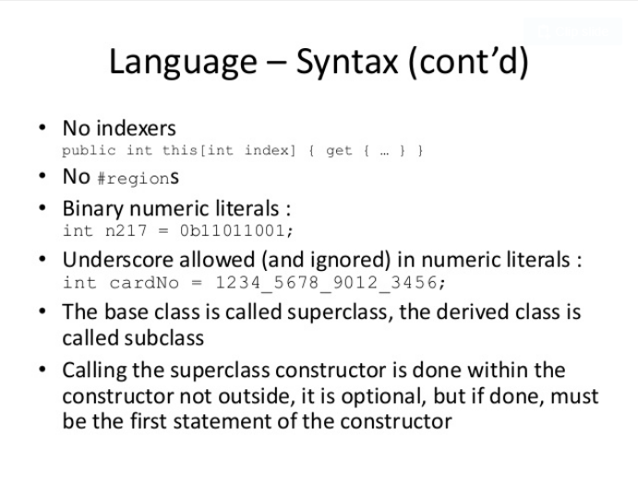

Slide 30
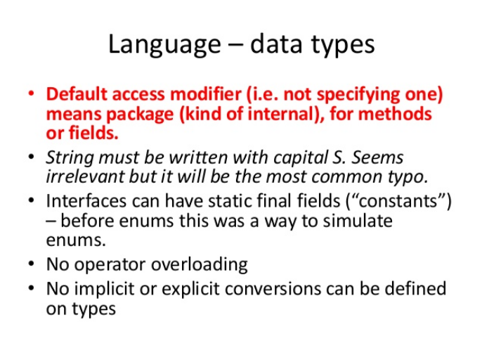

Slide 31
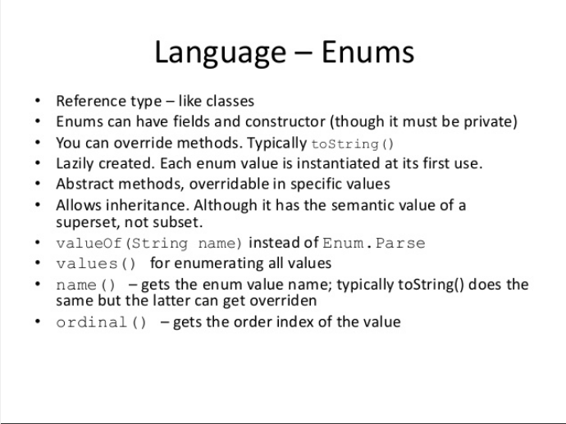

Slide 32
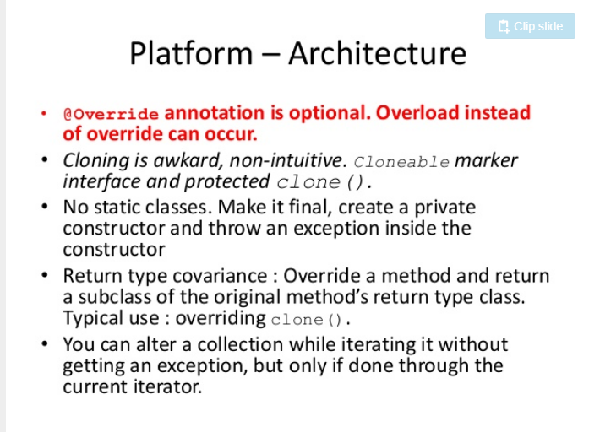

Slide 33
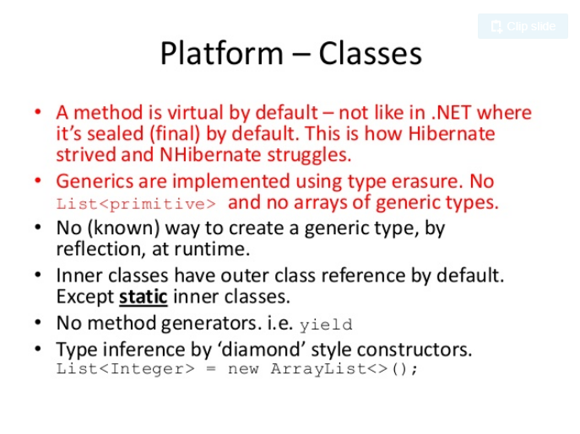

Slide 34
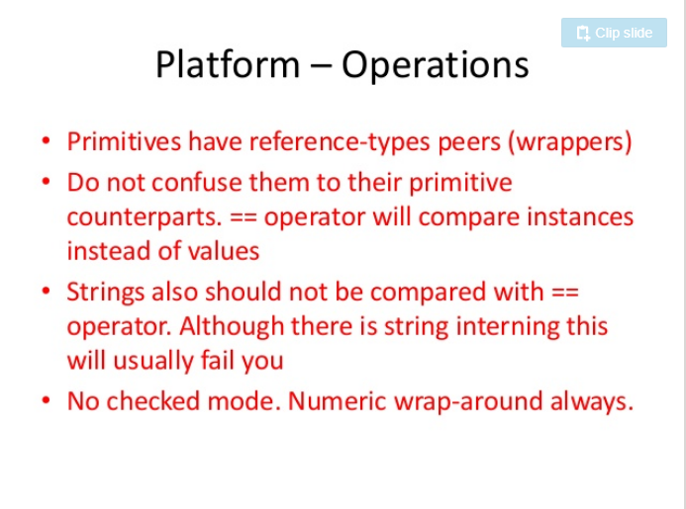

Slide 35
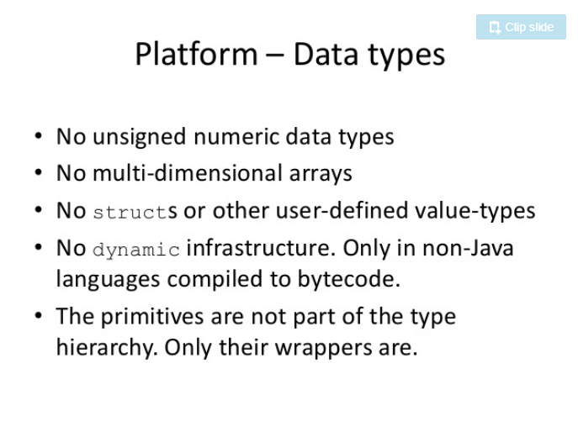

Slide 36
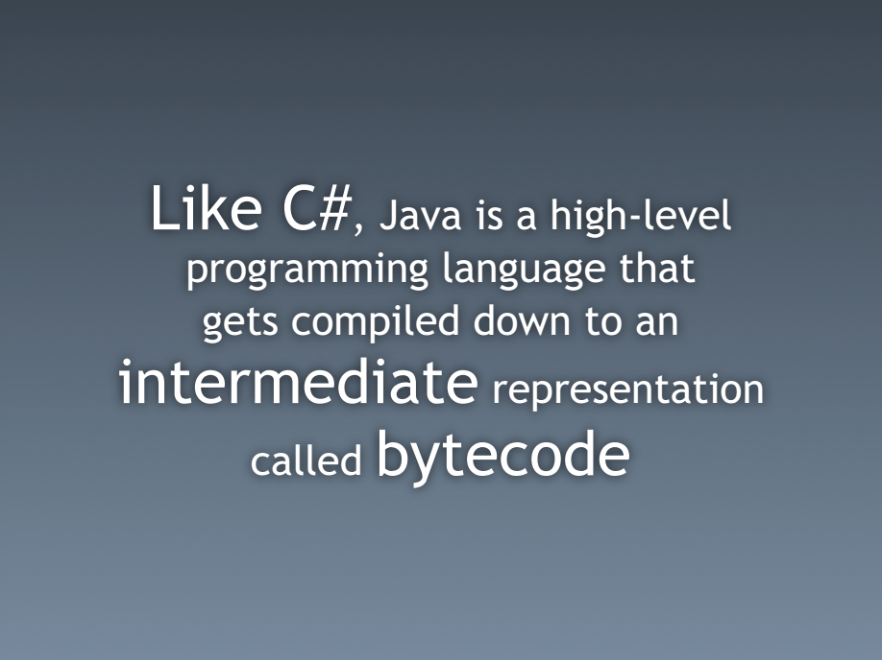

Slide 37
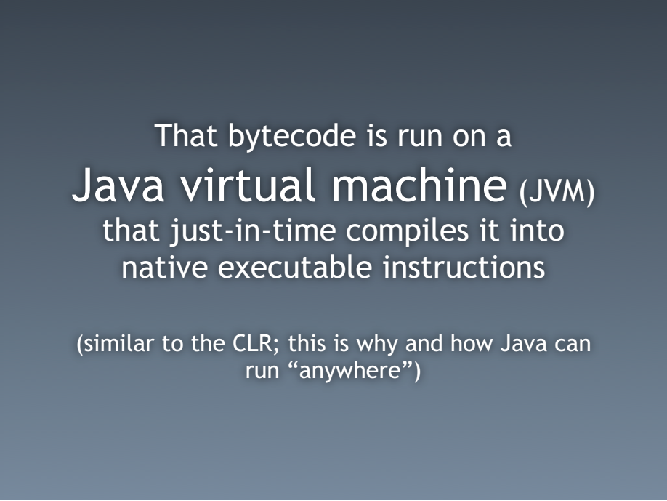

Slide 38


Slide 39


Slide 40


Slide 41
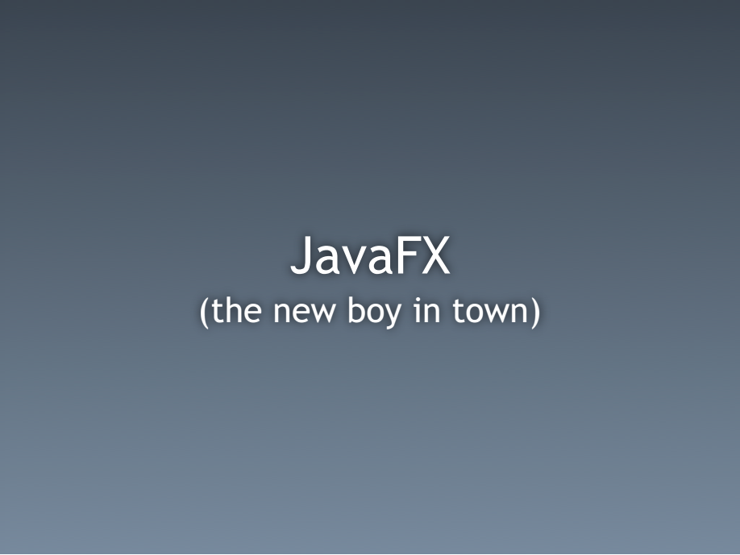

Slide 42


Slide 43
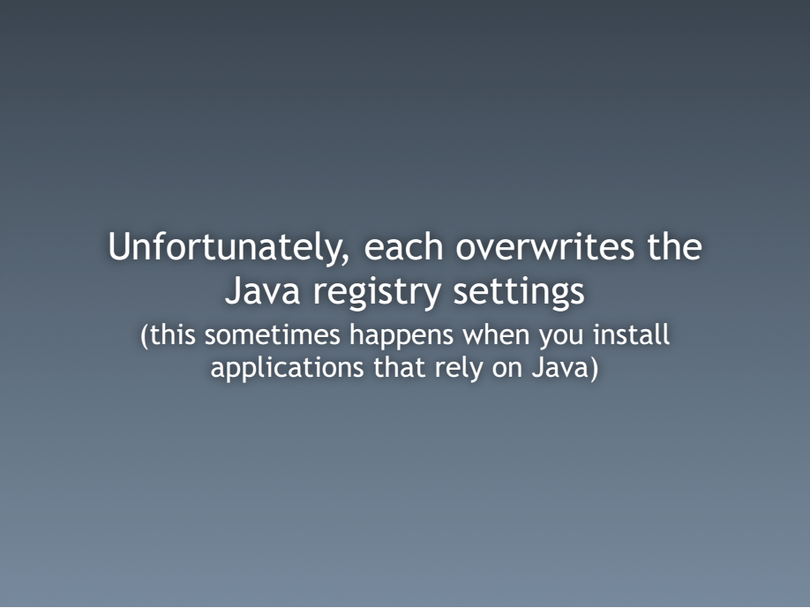

Slide 44


Slide 45
